Slide 1


Analyzing Amazon Sales data
Project 1

Slide 2
Introduction
Problem Statement:
Sales management has gained importance to meet increasing competition and the need for improved methods of distribution to reduce cost and to increase profits. Sales management today is the most important function in a commercial and business enterprise.
Do ETL: Extract-Transform-Load some Amazon dataset and
find for me Sales-trend -> month-wise, year-wise, yearly_month-wise
Find key metrics and factors and show the meaningful relationships between attributes.
Do your own research and come up with your findings.

Slide 3
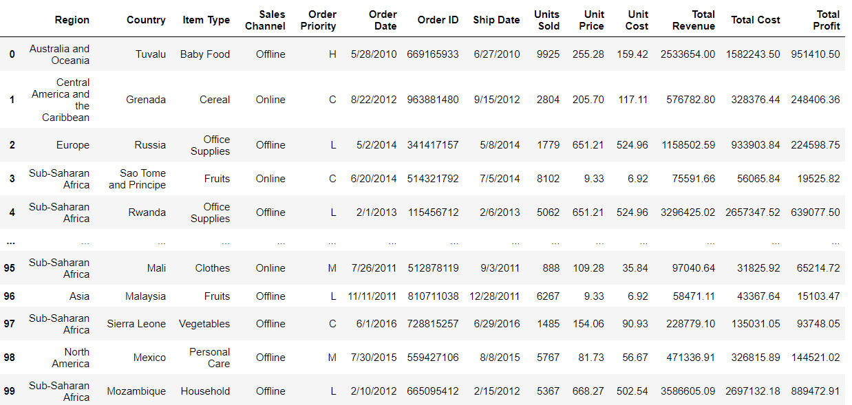
Amazon sales analysis
Amazon Sales data preview:

Slide 4
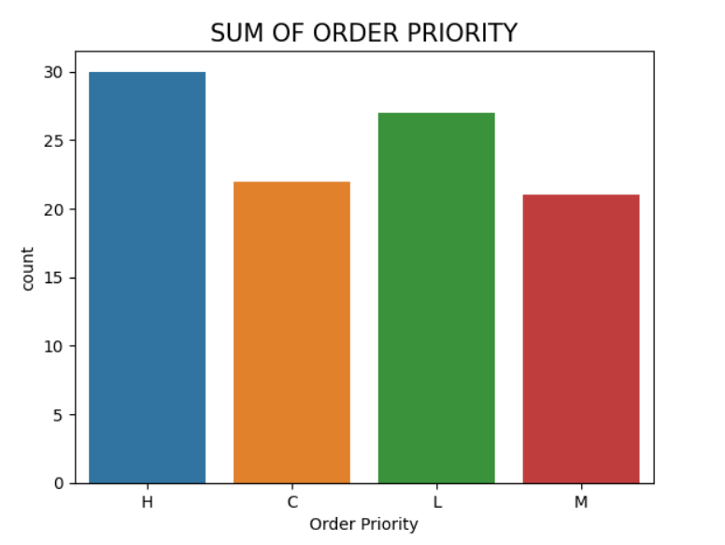
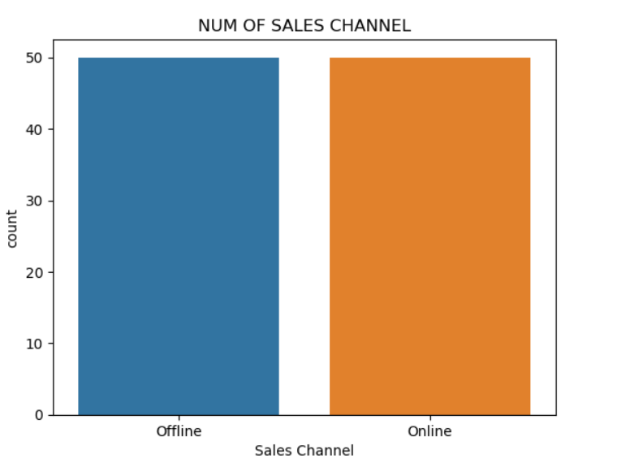
Amazon sales analysis
Sum of order priority & Number of sales channel:

Slide 5
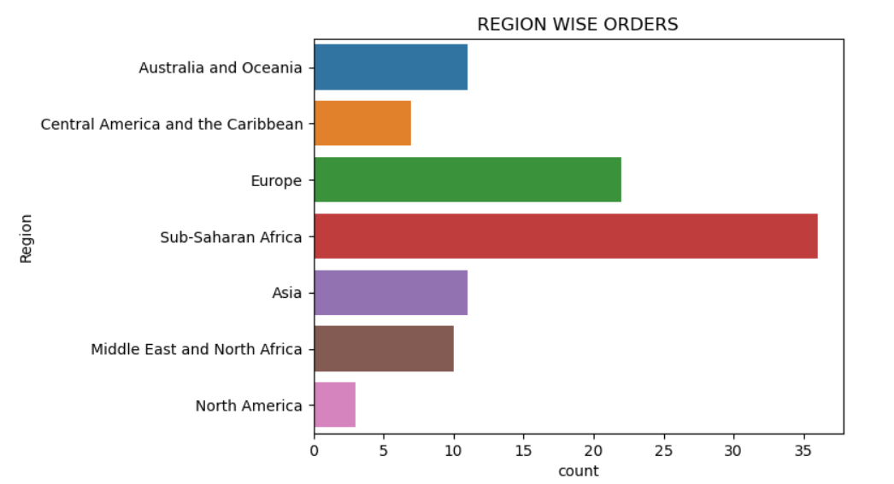
Amazon sales analysis
Region wise orders:

Slide 6
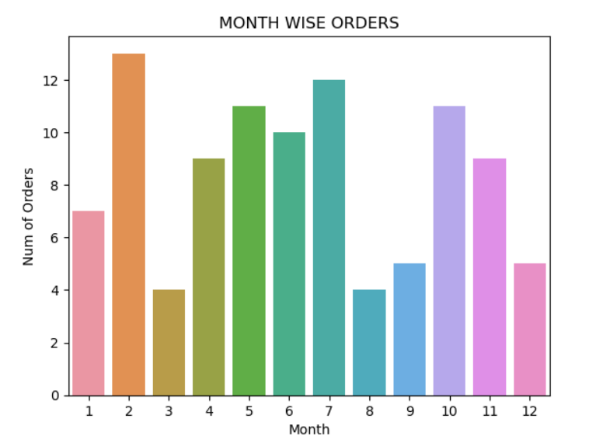
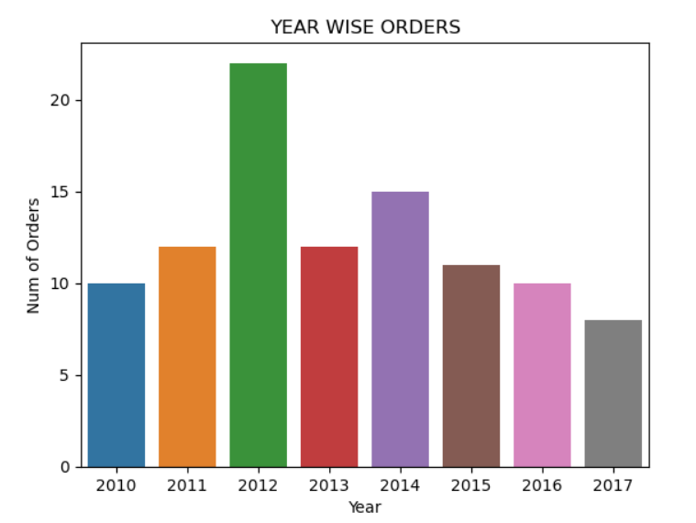
Amazon sales analysis
Month & Year wise orders:

Slide 7
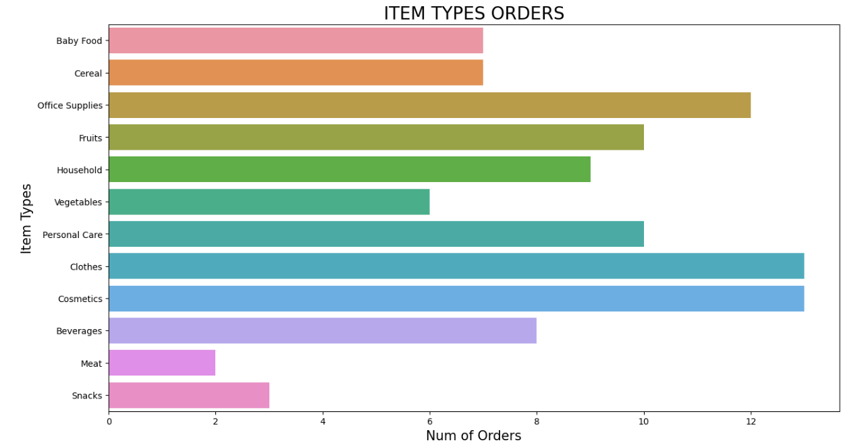
Amazon sales analysis
Number of item type orders:

Slide 8
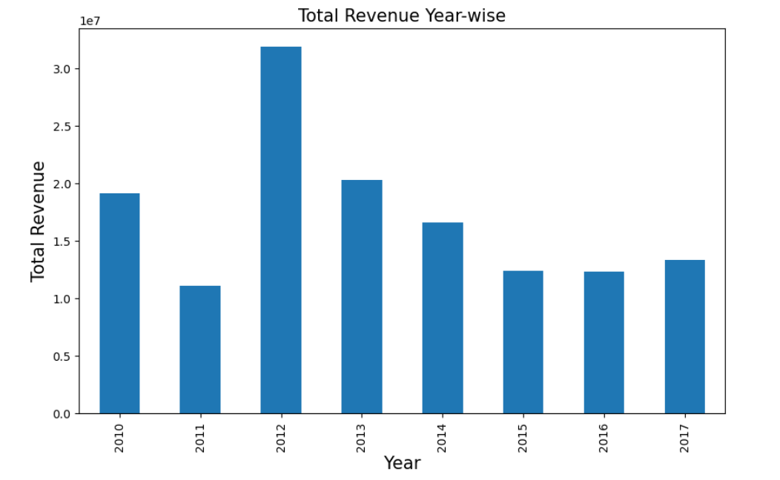
Amazon sales analysis
Total revenue year wise:

Slide 9
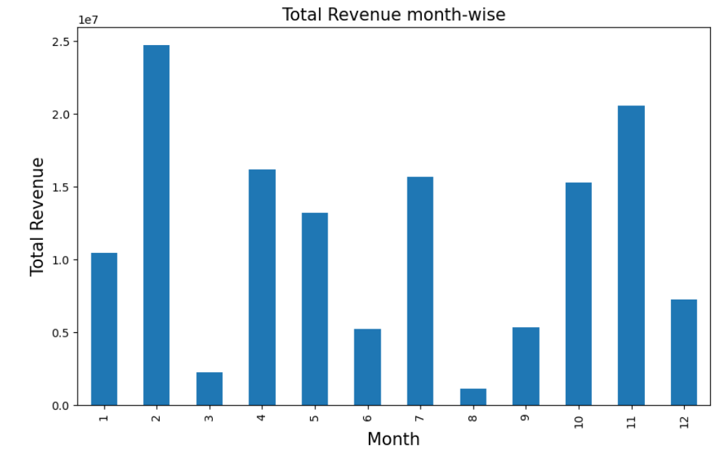
Amazon sales analysis
Total revenue Year wise & Month wise:

Slide 10
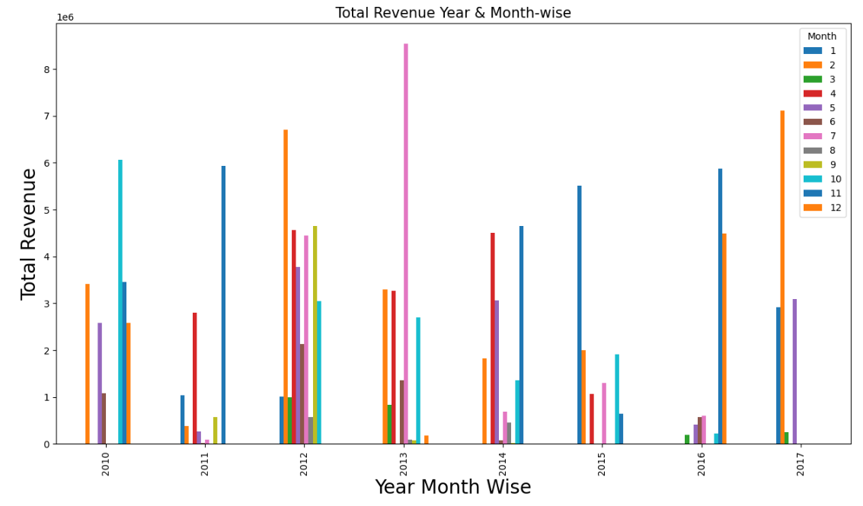
Amazon sales analysis
Total revenue Year & Month wise:

Slide 11
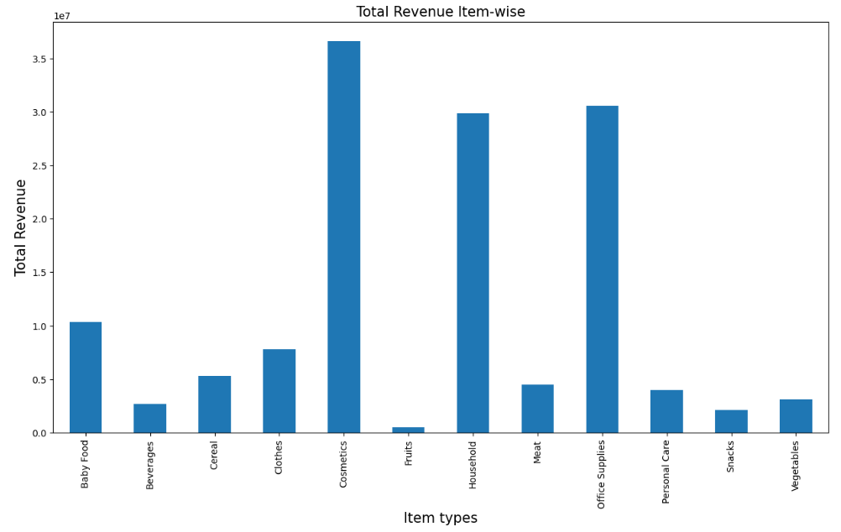
Amazon sales analysis
Total revenue Item type wise:

Slide 12
Thank You

